Slide 1
Employee Data Analysis using Excel
STUDENT NAME:R.SRINITHI
REGISTER NO: 312206546
DEPARTMENT:COMMERCE
COLLEGE:AGURCHAND MANMULL JAIN COLLEGE

Slide 2
PROJECT TITLE
Employee Performance Analysis using Excel

Slide 3


AGENDA
Problem Statement
Project Overview
End Users
Our Solution and Proposition
Dataset Description
Modelling Approach
Results and Discussion
Conclusion
3/21/2024 Annual Review

Slide 4

PROBLEM STATEMENT
Employee performance analysis is the process of evaluation an individual’s job performance ,usually conducted by their supervisor or manager .it involves assessing their work quality, productivity ,communication skills, teamwork and collaboration.

Slide 5

PROJECT OVERVIEW
Employee performance analysis using excel is the process of evaluation an individual’s job performance ,usually conducted by their supervisor or manager .
Then analysis the employee performance using excel.
Data collection for this employee analysis are employee’s name , ID, department and business unit.
Then calculate overall performance level using formulas in excel.
Using pivot table to analyse the given information.
After analysing the table then prepare a chart.

Slide 6


WHO ARE THE END USERS?
Employers
Organisation
Different industries
IT sectors
Manager
Employee’s

Slide 7

OUR SOLUTION AND ITS VALUE PROPOSITION
Filter : To remove missing values
Formula : To find out performance level
= IFS(Z8>=5,"VERY HIGH",Z8>=4,"HIGH",Z8>=3,"MED", TRUE,"LOW")
Pivot table : By highlighting the Emp.ID , first name , last name , business unit, employee status, employee type , employee classification type,
gender code, performance score , current employee rating, performance level to get the summary.
Graph : data visualization

Slide 8
Dataset Description
Employee dataset from Kaggle website
There are 26 features
I took 9 features for this analyse
1. Emp. ID –
2.First name
3.Last name 4.Gender : Male and female 5.Current employee rating : Through numerical 6.values 7.Business unit 8.Performance score 9.Employee status 10.Employee type

Slide 9

THE "WOW" IN OUR SOLUTION
Performance level = IFS(Z8>=5,"VERY HIGH",Z8>=4,"HIGH",Z8>=3,"MED", TRUE,"LOW")
3/21/2024 Annual Review
9

Slide 10
MODELLING
DATA COLLECTION : Employee dataset collected from Edunet dashboard in naan mudhalvan portal.
FEATURE COLLECTION :In the data collection highlighted the important topics for the employee performance analysis . The highlighted headings are Emp.ID, first name, last name, business unit, employee status, employee type, employee classification type, gender code, performance score, current employee rating, performance level.
DATA CLEANING :By applying the filtering option removed all the blank space in employee dataset . Using filtering option especially removed the blank from exit date column.
10

Slide 11
SUMMARY :By selecting all the columns in dataset, then selected pivot table option. In pivot table by highlighting the some side headings in values enter count of first name, in rows enter business unit, in columns enter performance level, in filter enter gender code to get the summary . Then the data will turned into table format.
Visualization :After analyzing the table then prepare a graph . Now, we can visualize the graph for an employee performance analysis . With this progress we can regularly review the employee’s progress, provide on going feedback and adjust the growth plan as needed.

Slide 12
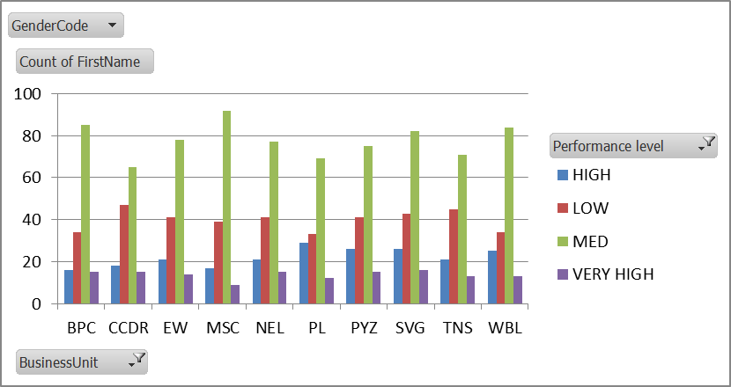
RESULTS
12

Slide 13
conclusion
While we comparing the performance of the employees, the number of employees are highly performed PL sector of the organization. We should motivate the employees of the other sectors by giving different kinds of tasks based on their strength, in order to improve the standard of the organization.

